Slide 1

Personalized Health App Using Artificial Intelligence
Revolutionizing Healthcare Through Intelligent Personalization

Slide 2



Team Members
2300030936 P.Yashwin Chowdary
2300031312
P.Madhav

Slide 3

1
Generic Limitations
Traditional health apps deliver one-size-fits-all recommendations that ignore individual needs, genetics, and lifestyle patterns.
The Personalization Gap
Users lack real-time, adaptive insights that evolve with their changing health status and personal goals.
2
Evolution
AI-Powered Solution
Artificial intelligence enables hyper-personalized recommendations by analyzing fitness data, nutrition patterns, mental health metrics, and predictive diagnostics simultaneously.
3

Slide 4

The Problem We Solve
• Generic health plans fail to account for individual circumstances
• Limited feedback prevents behavioral adaptation
• Reactive rather than predictive healthcare approaches
• Users struggle with data interpretation and decision-making

Slide 5







Objectives
Continuous Monitoring
Real-time collection and analysis of comprehensive health metrics
Risk Prediction
AI-powered early detection of potential health complications
Adaptive Plans
Dynamically personalized wellness strategies that evolve with user progress
Sustained Engagement
Building long-term healthy habits through intelligent encouragement

Slide 6
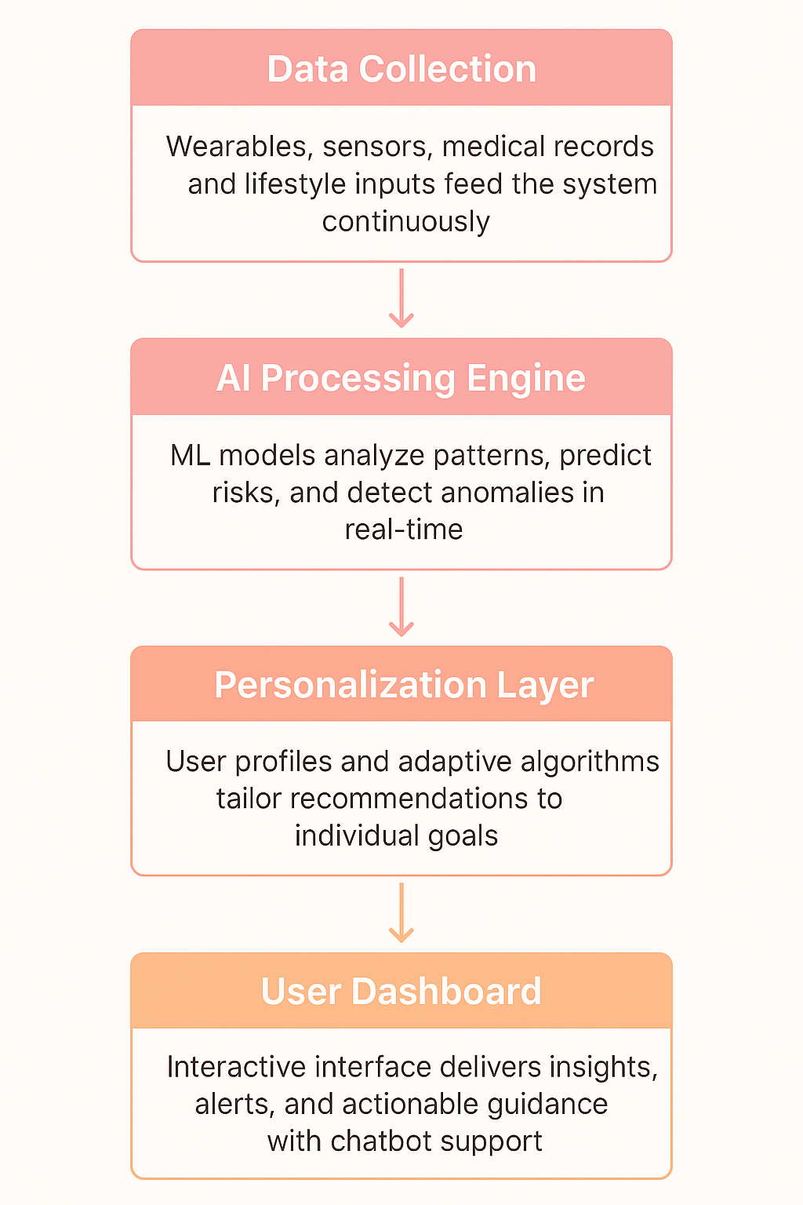
System Architecture

Slide 7




AI Techniques Powering Personalization
Machine Learning
Predictive models analyze health trends, activity patterns, and identify behavioral correlations that inform recommendations
Natural Language Processing
Conversational AI chatbots understand user queries and provide contextual health guidance through natural dialogue
Computer Vision
Image analysis enables non-invasive health assessments including skin condition monitoring and physical
form evaluation
Recommendation Systems
Intelligent algorithms curate customized diet plans, workout routines, and supplement suggestions aligned with
individual goals

Slide 8
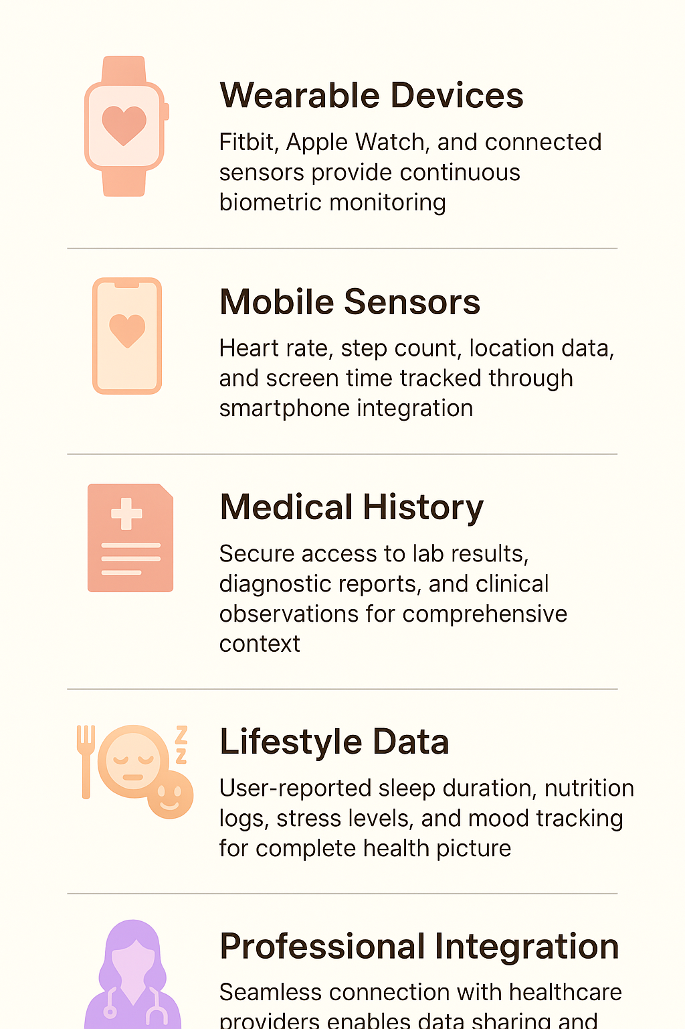
Multi-Source Data Integration
Wearable Devices
Fitbit, Apple Watch, and connected sensors provide continuous biometric monitoring
Mobile Sensors
Heart rate, step count, location data, and screen time tracked through smartphone integration
Medical History
Secure access to lab results, diagnostic reports, and clinical observations for comprehensive context
Lifestyle Data
User-reported sleep duration, nutrition logs, stress levels, and mood tracking for complete health picture
Professional Integration
Seamless connection with healthcare providers enables data sharing and clinical recommendations

Slide 9
The Future of Personalized Healthcare
Personal
Hyper-individualized health strategies respecting genetic, environmental, and behavioral uniqueness
Predictive
Anticipatory healthcare that identifies risks before symptoms emerge
Proactive
Empowered users take preventive action guided by intelligent AI recommendations

Slide 10

Conclusion
The Personalised Health App powered by Artificial Intelligence revolutionizes the way individuals manage their well-being by transforming raw health data into meaningful, actionable insights. By integrating data from wearables, mobile sensors, medical history, lifestyle inputs, and professional feedback, the system enables continuous, intelligent, and adaptive health monitoring.
Ultimately, this AI-driven platform bridges the gap between personal wellness and professional healthcare, promoting preventive care, data-driven decisions, and a healthier, more informed society.

Slide 11


Thank you!

